Slide 1
Modeling the Performance of an FMTV A2 with a Vehicle Integrated Power Kit (VIPK)
Bryant Goodenough, PhD¹, Henry Schmidt¹, Jeffrey D. Naber, PhD¹, Paul Dice¹,
Dave Subert¹, Kevin Meyers¹
¹ Advanced Power Systems
Research Center (APS LABS),
Michigan Technological University,
Houghton, MI
DISTRIBUTION STATEMENT A.
Approved for public release; distribution is unlimited.

Slide 2

Background & Motivation
Power requirements are expanding for critical battlefield systems
VIPK lessens reliance on conventional generators, logistic demands, and quickly delivers tactical power
Provides uninterrupted power On-The-Move. Ability to support rapid fire shoot-and-relocate
VIPK closes capability gap to enable tactical mobility and sustainment
VIPK enables electrical power generation on existing vehicle platforms
2
DISTRIBUTION STATEMENT A. Approved for public release; distribution is unlimited.

Slide 3
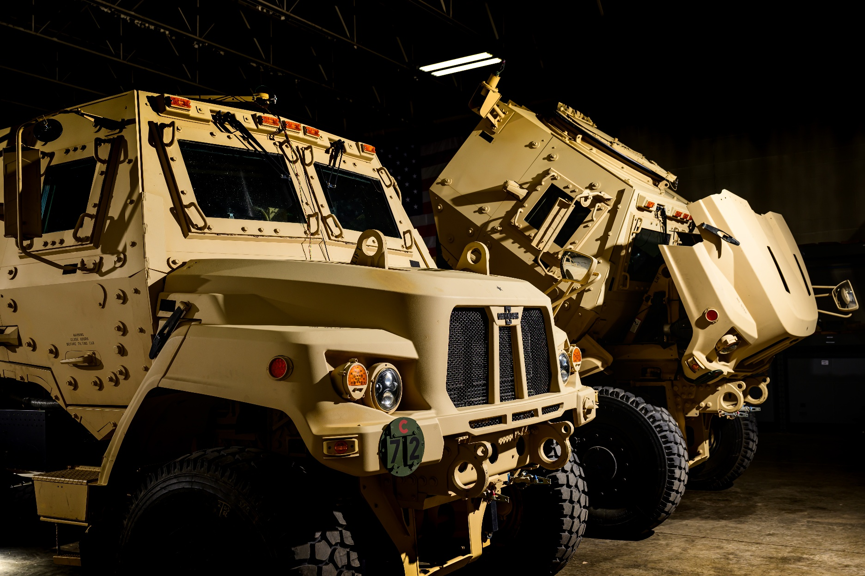

Project Introduction
Michigan Tech. University (MTU) awarded a competitively solicited project through Defense Innovation Unit (DIU) OTA
Scope:
    Engineer VIPK solution and integrate onto the FMTV A2
  Interface with existing powertrain
  Compatibility with multiple variants
  Meet or exceed performance requirements
3
DISTRIBUTION STATEMENT A. Approved for public release; distribution is unlimited.

Slide 4



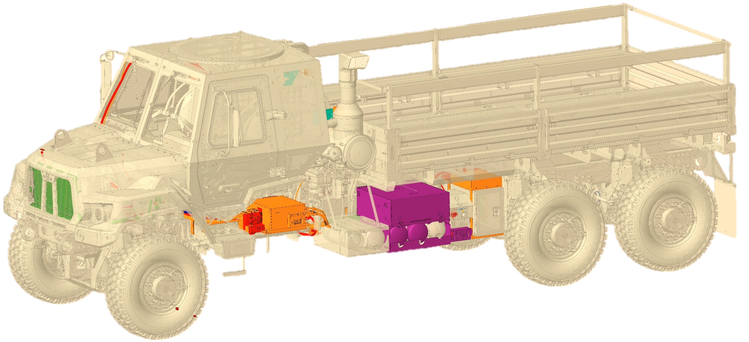
MTU VIPK Critical Attributes
Vehicle | 600 VDC Export | 208/120 VAC Export | 28 VDC Export | EPK¹ | TMS^{2,3} Compatibility
14 kW
FMTV A2 (Baseline)
Stationary
120 kW
60 kW
18 kW
On-The-Move
FMTV A2 with MTU VIPK
30 kW
30 kW
18 kW
¹ EPK is the Expeditionary Power Kit, enabling engine off cabin conditioning and 1.8 kW of 120 VAC
² TMS is the Tactical Microgrid Standard (MIL-STD-3071)
³ Bohn, F. W. Overview of MIL-STD-3071 – Tactical Microgrid Standard. U.S. Army Combat Capabilities Development Command (DEVCOM), C5ISR Center.
4
DISTRIBUTION STATEMENT A. Approved for public release; distribution is unlimited.

Slide 5
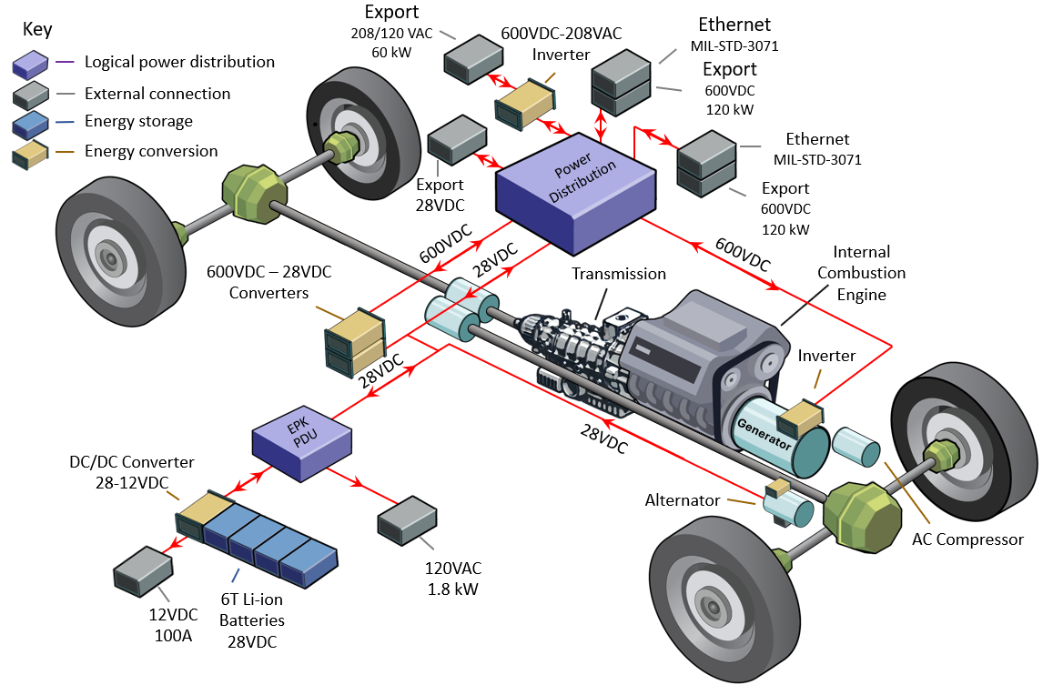
MTU’s Solution
Key characteristics:
Maintains existing vehicle engine and drivetrain
High TRL COTS and MOTS components
No high voltage energy storage
Vehicle operation remains if kit becomes unavailable
5
DISTRIBUTION STATEMENT A. Approved for public release; distribution is unlimited.

Slide 6
MTU VIPK Development Process
This presentation
Current project phase
Architecture selection
Model development & calibration
Performance studies
MTU VIPK integration
MTU VIPK experimental testing
Model developed to provide performance results prior to testing
6
DISTRIBUTION STATEMENT A. Approved for public release; distribution is unlimited.

Slide 7

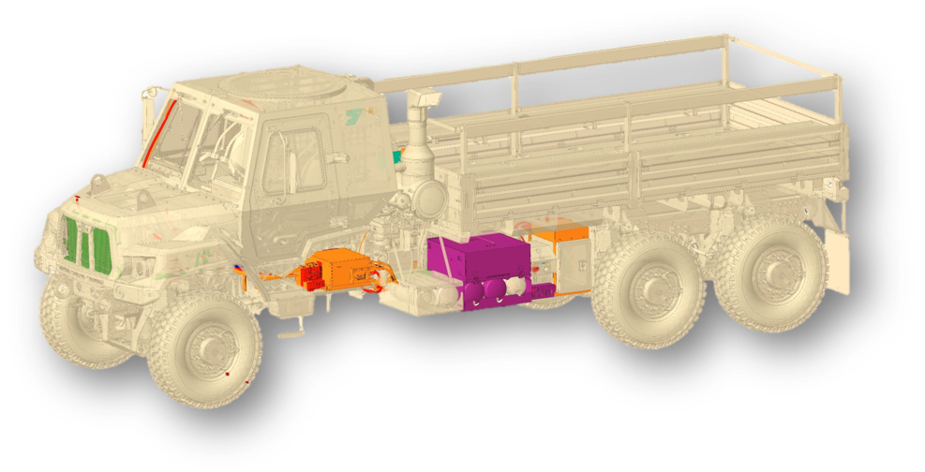
Study Overview
Compare
FMTV A2 (Baseline)
FMTV A2 with MTU VIPK
This study compares FMTV A2 (Baseline) to FMTV A2 with MTU VIPK
Model comparison objectives:
Accelerate design decisions
Reduce development costs and risks
Inform control strategy
Predict vehicle performance
7
DISTRIBUTION STATEMENT A. Approved for public release; distribution is unlimited.

Slide 8
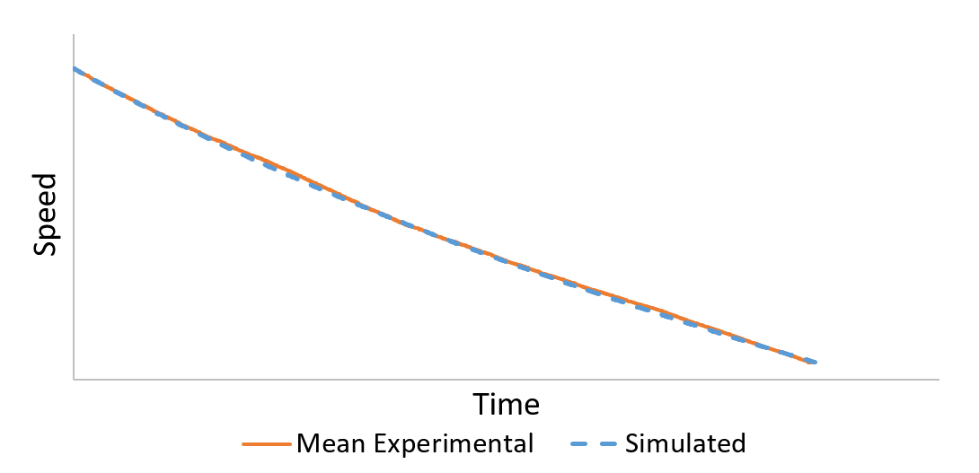
Baseline Model & Calibration
Experimental coastdown testing performed
Additional experimental data obtained for other components
Calibration ensures representative system behavior
Baseline model developed in Simcenter Amesim
Coastdown
comparison
 | Experimental vs. Simulated: FMTV M1083A2 (baseline)
Accel: 0 to 30 mph | 1% different
Accel: 0 to 50 mph | 7% different
Top Speed | 6% different¹
¹ Experimental top speed constrained by available track length
Calibrated baseline model enables MTU VIPK model development
8
DISTRIBUTION STATEMENT A. Approved for public release; distribution is unlimited.

Slide 9
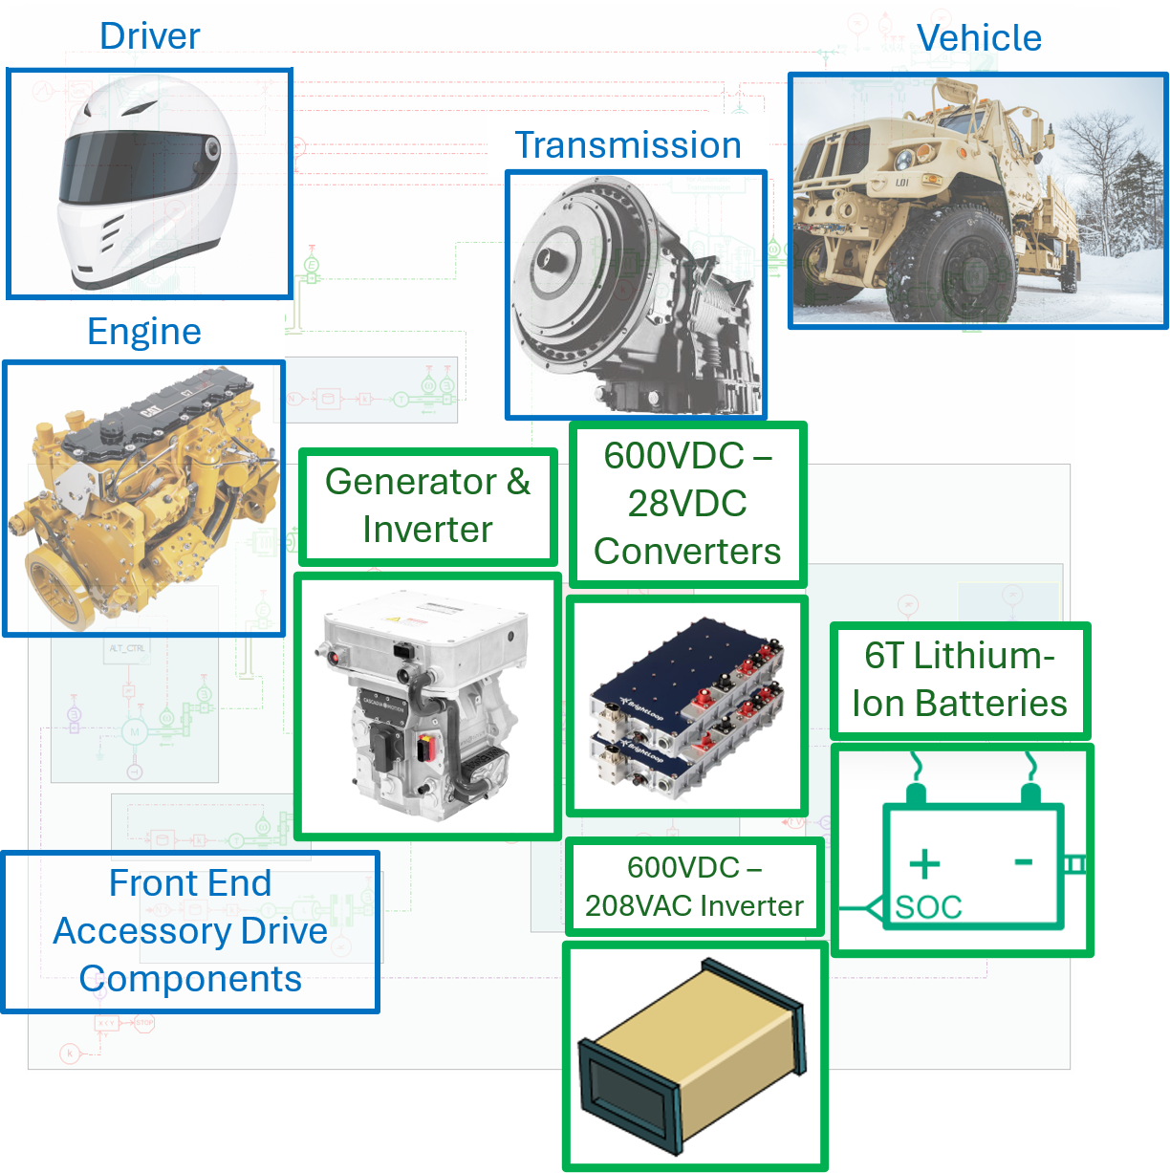
Adding MTU VIPK to Baseline Model
Major additions are outlined in green
Specifications and manufacturer data used for components
Simcenter Amesim model of FMTV A2 with MTU VIPK
9
DISTRIBUTION STATEMENT A. Approved for public release; distribution is unlimited.

Slide 10
Results: Performance Impact of MTU VIPK with Power On-The-Move
DC/DC converters offset high voltage (HV) and drivetrain loads without HV energy storage
MTU VIPK Export Condition: Power On-The-Move¹ | 0 kW HV Export | 10 kW HV Export | 20 kW HV Export | 30 kW HV Export
Transient Propulsion Performance vs. Baseline
0 kW
10 kW
20 kW
30 kW
Improve
Improve
Equal
Reduce
¹ 120°F ambient at GVW
MTU VIPK improves propulsion performance with power On-The-Move up to 20 kW
10
DISTRIBUTION STATEMENT A. Approved for public release; distribution is unlimited.

Slide 11
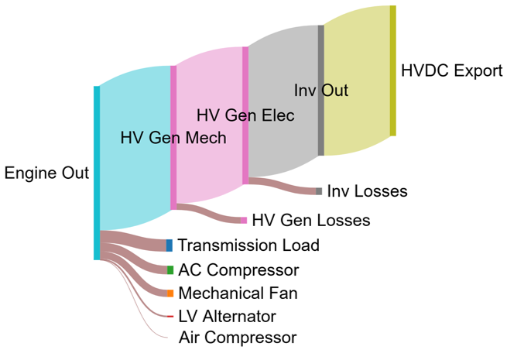
VIPK Results: Stationary Power Flow
at 120 kW of 600 VDC
Operation: 120 kW, 600 VDC power export while stationary
From engine output power:
    ○ 83% supports HVDC export
    ○ 7% to transmission load
    ○ 10% to air conditioning compressor, fan, and alternator
    Equivalent auxiliary generator weighs ~10,000 pounds
Power flow of 120 kW 600 VDC stationary power export
11
DISTRIBUTION STATEMENT A. Approved for public release; distribution is unlimited.

Slide 12
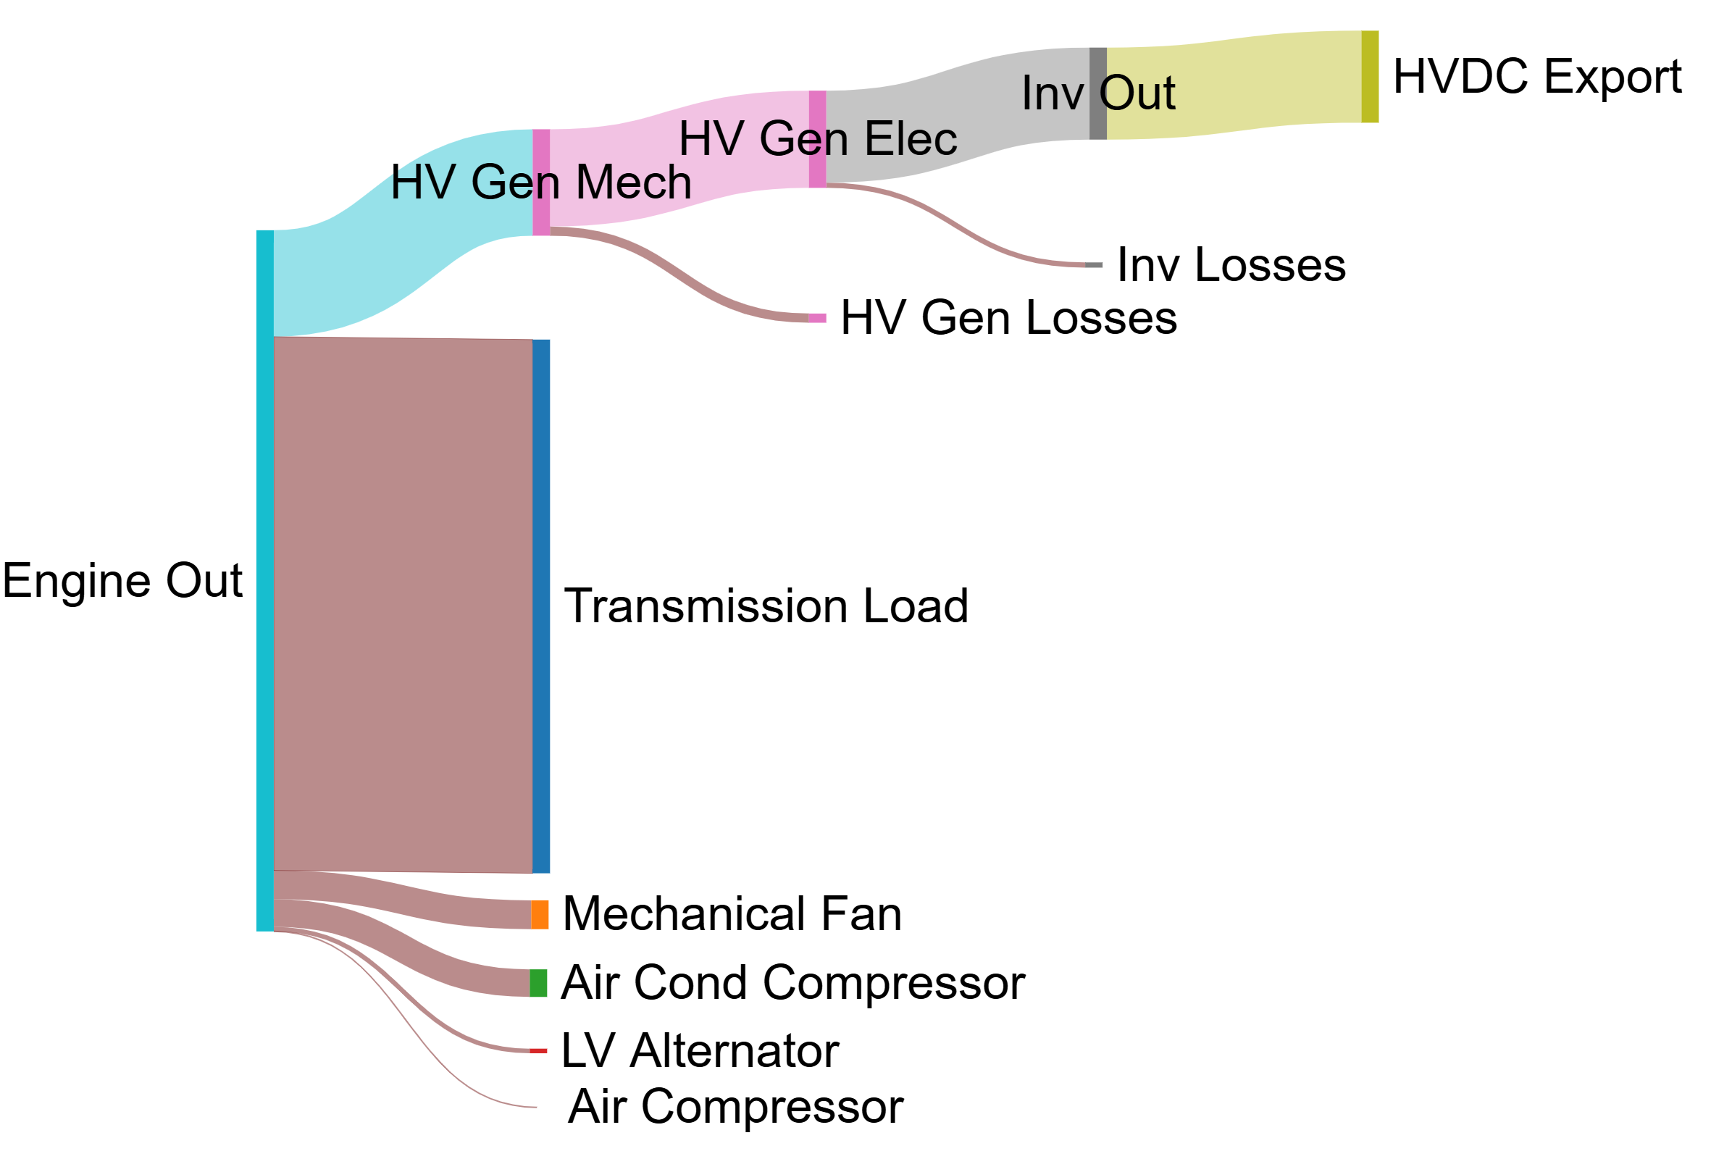
VIPK Results: On-The-Move Power Flow at 30 kW of 600 VDC
Operation: 30 kW, 600 VDC power on-the-move while at max vehicle speed
From engine output power:
○ 15% supports HVDC export
○ 76% to transmission load (vehicle propulsion)
○ 9% to air conditioning compressor, fan, and alternator
Power flow of 30 kW 600 VDC power export at max vehicle speed
12
DISTRIBUTION STATEMENT A. Approved for public release; distribution is unlimited.

Slide 13

MTU VIPK Conclusions
Enables electrical power generation on existing vehicle platforms
○ Stationary: 120 kW of power export
○ Power On-The-Move: 30 kW of power export while performing OMS/MP
Expeditionary Power Kit (EPK) functionality
Tactical Microgrid Standard (TMS) compliant
No high voltage energy storage
MTU VIPK improves propulsion performance during power On-The-Move up to 20 kW
13
DISTRIBUTION STATEMENT A. Approved for public release; distribution is unlimited.

Slide 14
Future Work
Delivering M1078A2 and M1083A2 vehicle variants in 1Q FY27
Government test and evaluation including safety release
Technology demonstrations:
○ Ft. Hood, TX
○ NTC, CA
○ Washington DC
○ Detroit Arsenal
○ Camp Shelby
Safety verification and confirmation
Level 2 and Level 3 Technical Data Package (TDP)
14
DISTRIBUTION STATEMENT A. Approved for public release; distribution is unlimited.

Slide 15
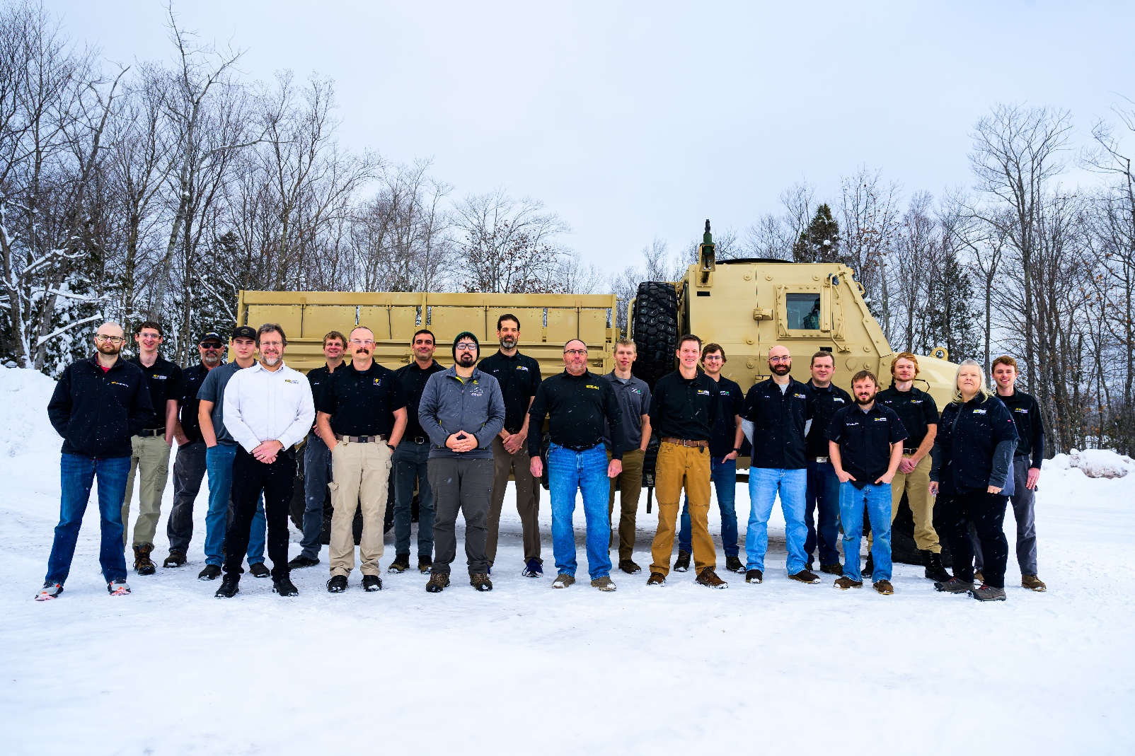



Acknowledgments
Portfolio Acquisition Executive (PAE) Agile Sustainment and Ammunition (AS&A)
Capability Program Executive (CPE) Combat Sustainment (CS)
Project Manager (PM) Transportation Systems (TS)
Product Director (PdD) Multi-Mission Protected Vehicle Systems (MPVS)
Office of Secretary of War Defense Innovation Unit (DIU)
Office of Secretary of War Operational Energy-Innovation (OE-I)
Ground Vehicle System Center (GVSC)
Combat Capabilities Development Command
Thank you to our partners including Oshkosh Defense, GS Engineering, SOLI Consulting, LSA Solutions
15
DISTRIBUTION STATEMENT A. Approved for public release; distribution is unlimited.

Slide 16
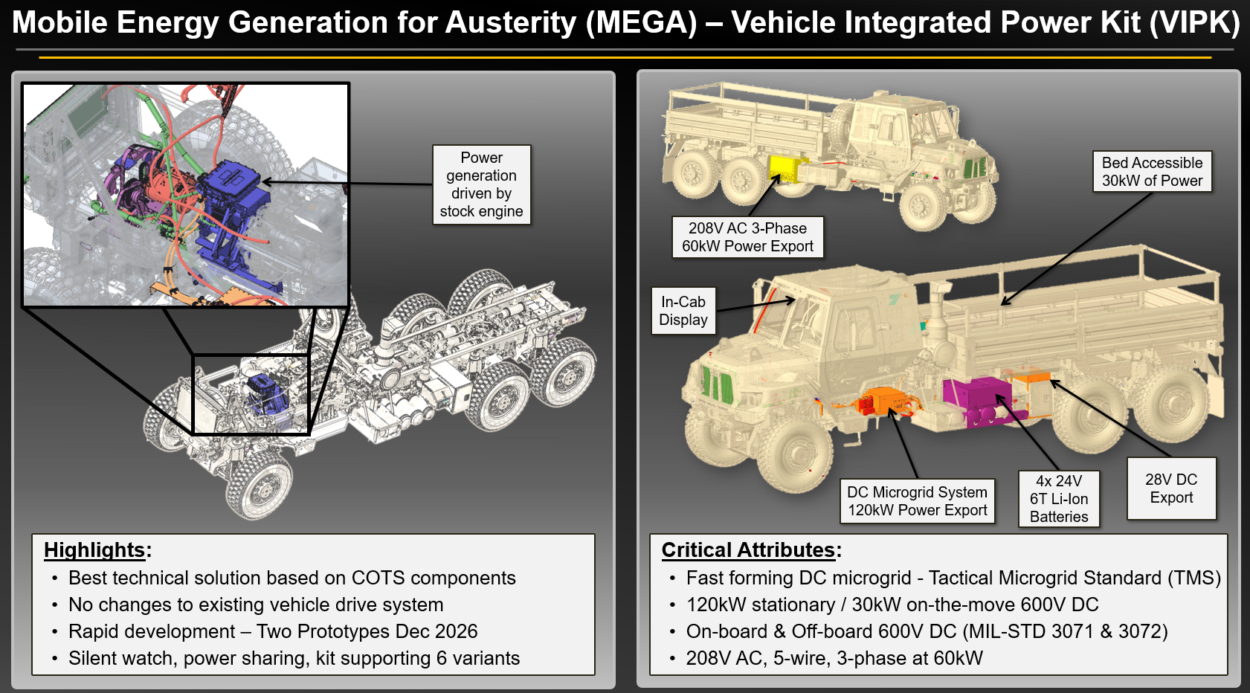
Backup Slides: MTU VIPK
16
DISTRIBUTION STATEMENT A. Approved for public release; distribution is unlimited.

Slide 17
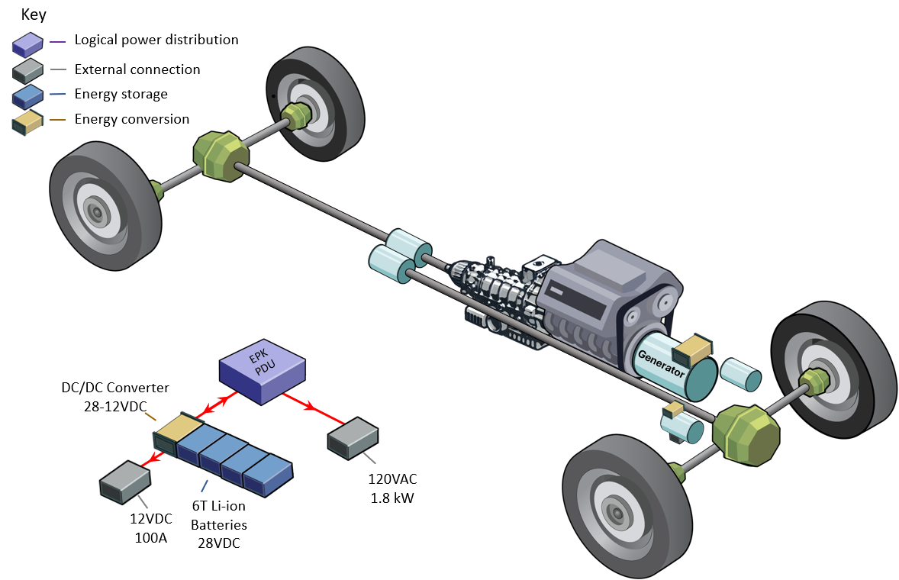
Backup Slides: Expeditionary Power Kit (EPK)
Engine-off cabin heating and cooling
  ○ Sprag clutch enables generator to spin without spinning engine
Fuel-fired heater for engine-off engine warming in Arctic conditions
Fuel savings
120 VAC single phase up to 1.8 kW
17
DISTRIBUTION STATEMENT A. Approved for public release; distribution is unlimited.

